Slide 1
Problem Statement
Redesign and implement a user friendly Flight, Car Hire, Hotel & Holiday booking Application with advanced functionality and easy usability.

Slide 2
Project Overview
The main purpose of this project is to design an onlline e-commerce system for like Kulula airlines. The system should allow the customer to search flights, search car hires, search for hotels as well as book and manage a ticket based on their needs. The system will include the eight features of e-commerce ,namely: ubiquity, global reach, universal standards, richness, interactivity, information density, personalisation and lastly social technology. The system will be user-friendly.

Slide 3
OOP Principles Followed:
Encapsulation: the internal representation of an object is generally hidden from view outside of the object’s definition.
Abstraction: Hiding internal details and showing functionality is known as abstraction. Abstraction is closely tied to encapsulation and in a sense that it hides internal details of a class and only show its functionality.
Inheritance: When one object acquires all the properties and behaviours of parent object. It provides code reusability.
Polymorphism: one object have many forms. Polymorphism manifests itself by having multiple methods all with the same name, but slightly different functionality.

Slide 4
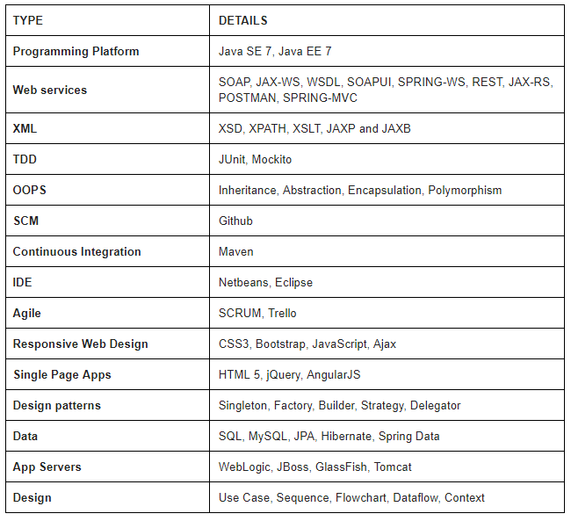
Ecommerce Platform

Slide 5
Use-case diagram
Follow link https://go.gliffy.com/go/share/s24w5fnn2o1523nq2imi

Slide 6
Class diagram
Follow link https://go.gliffy.com/go/publish/12583474

Slide 7
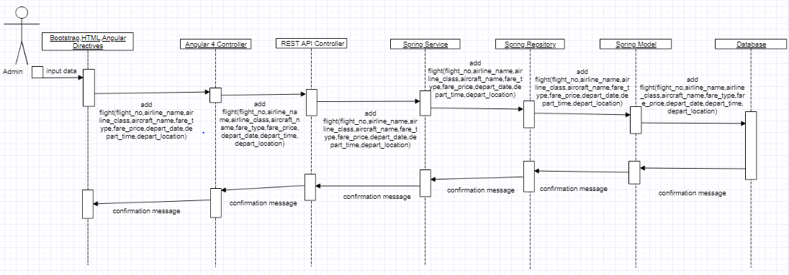
Sequence diagram snippet

Slide 8
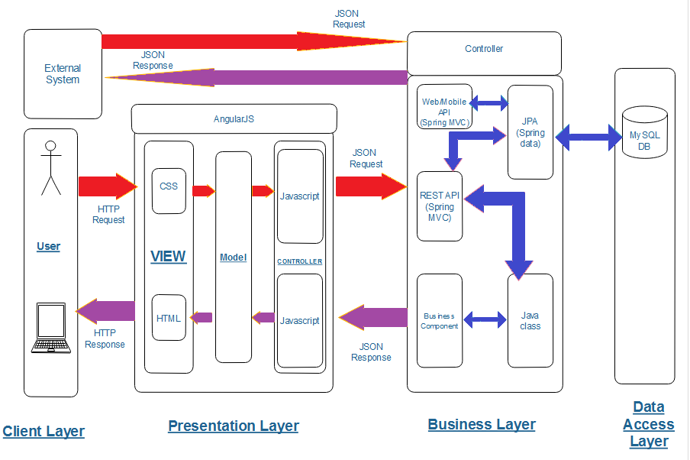
Architecture Diagram

Slide 9
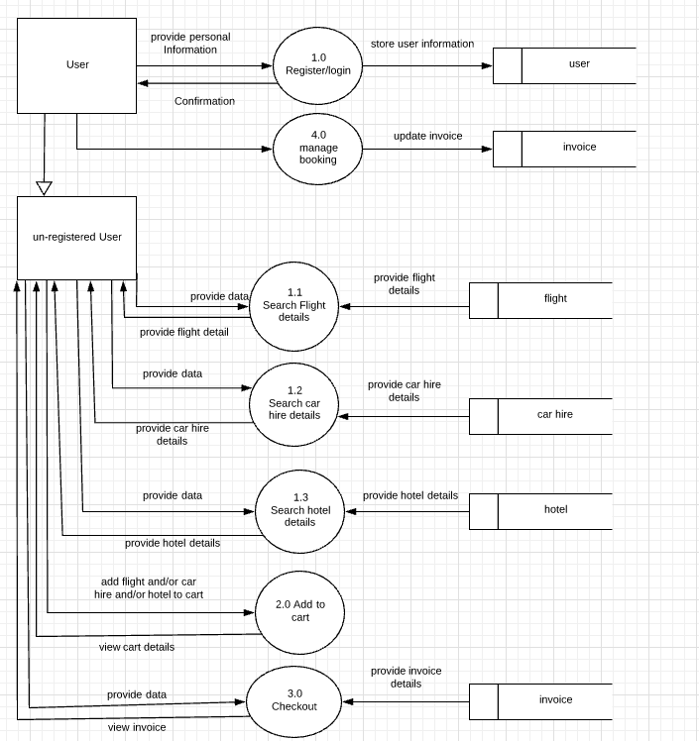
Data Flow Diagram

Slide 10
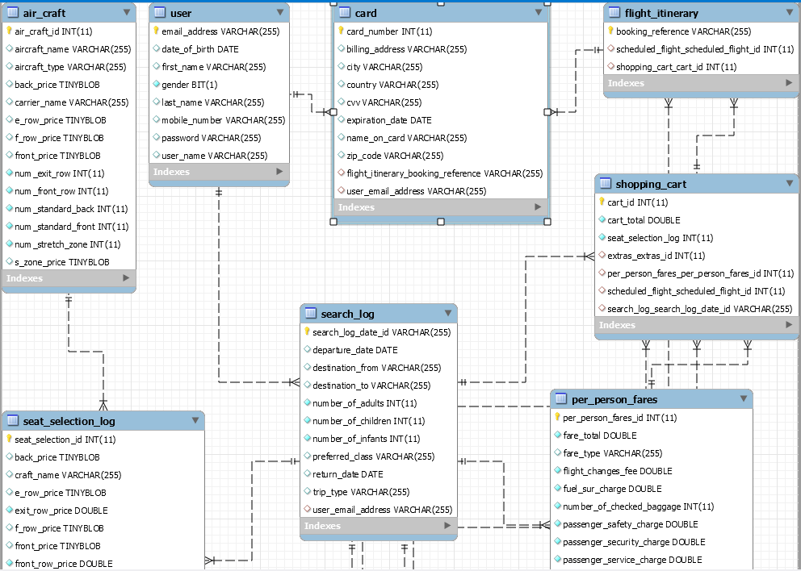
FLIGHTS ERD DIAGRAM

Slide 11
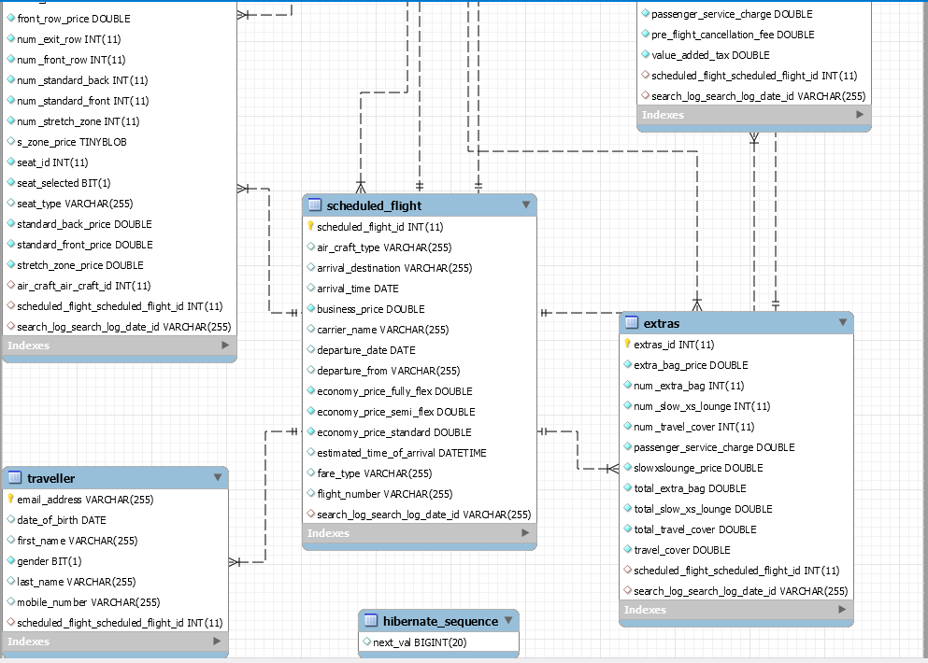

Slide 12
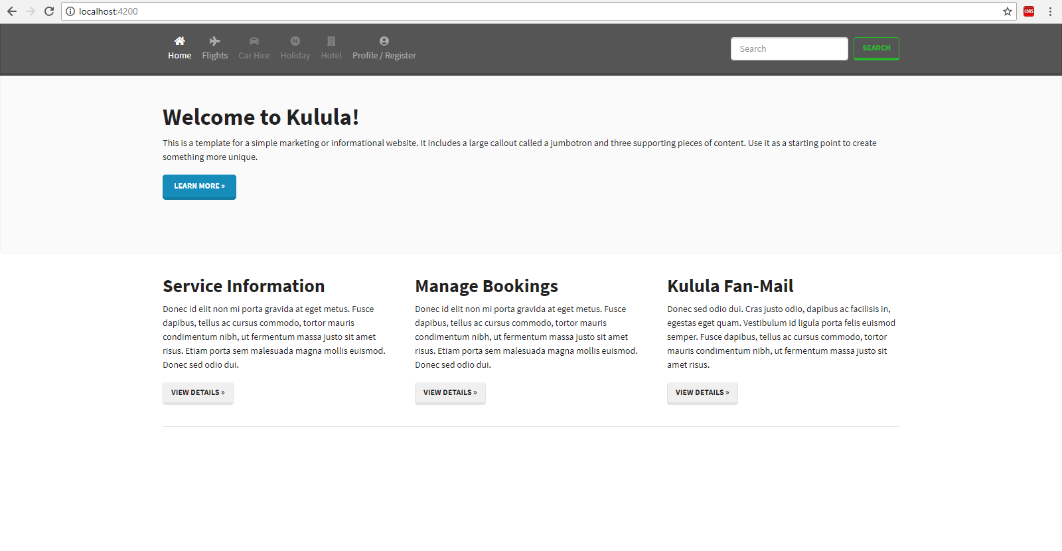
UI diagram

Slide 13
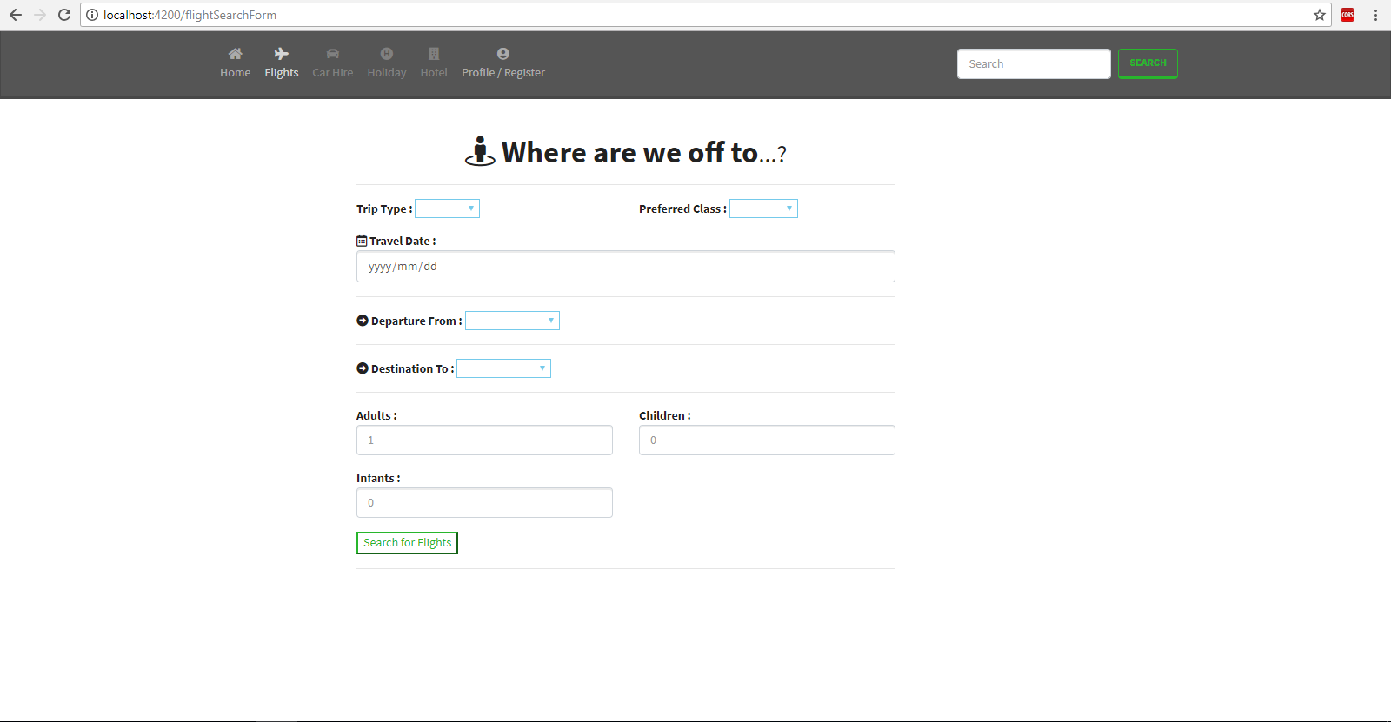

Slide 14
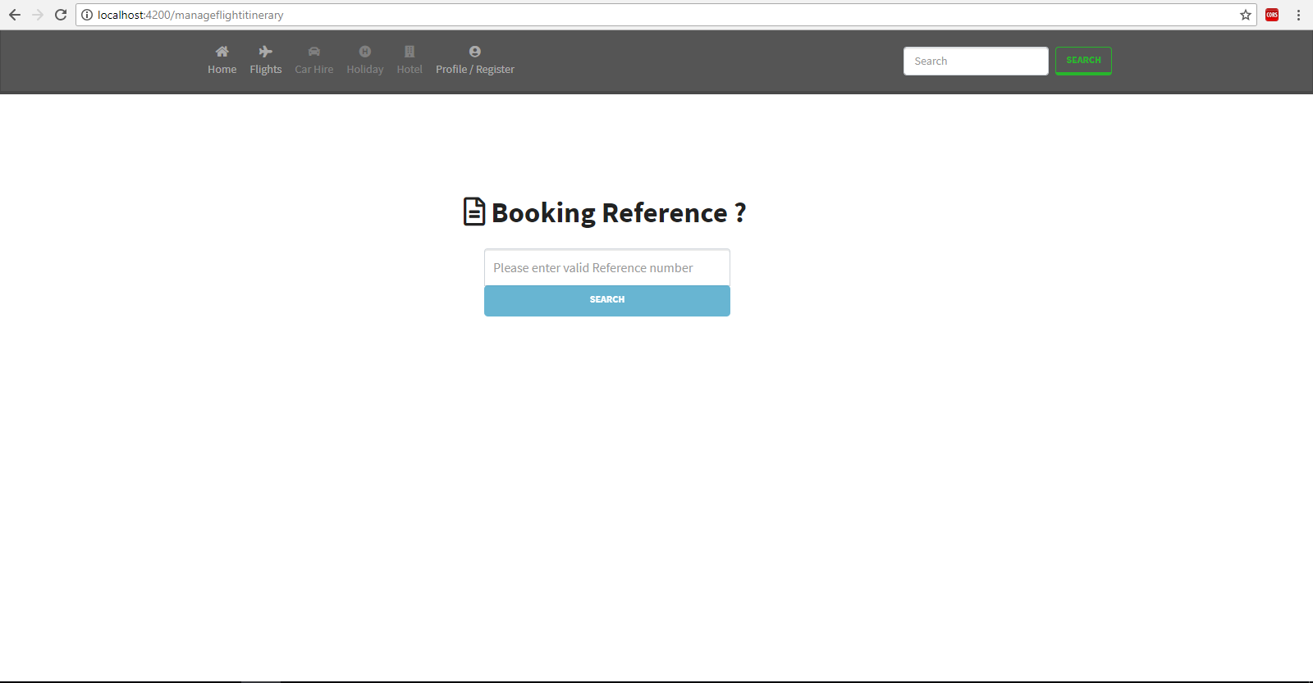

Slide 15
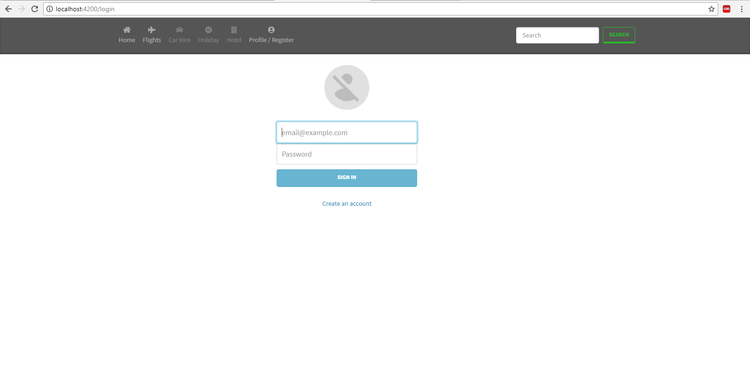

Slide 16
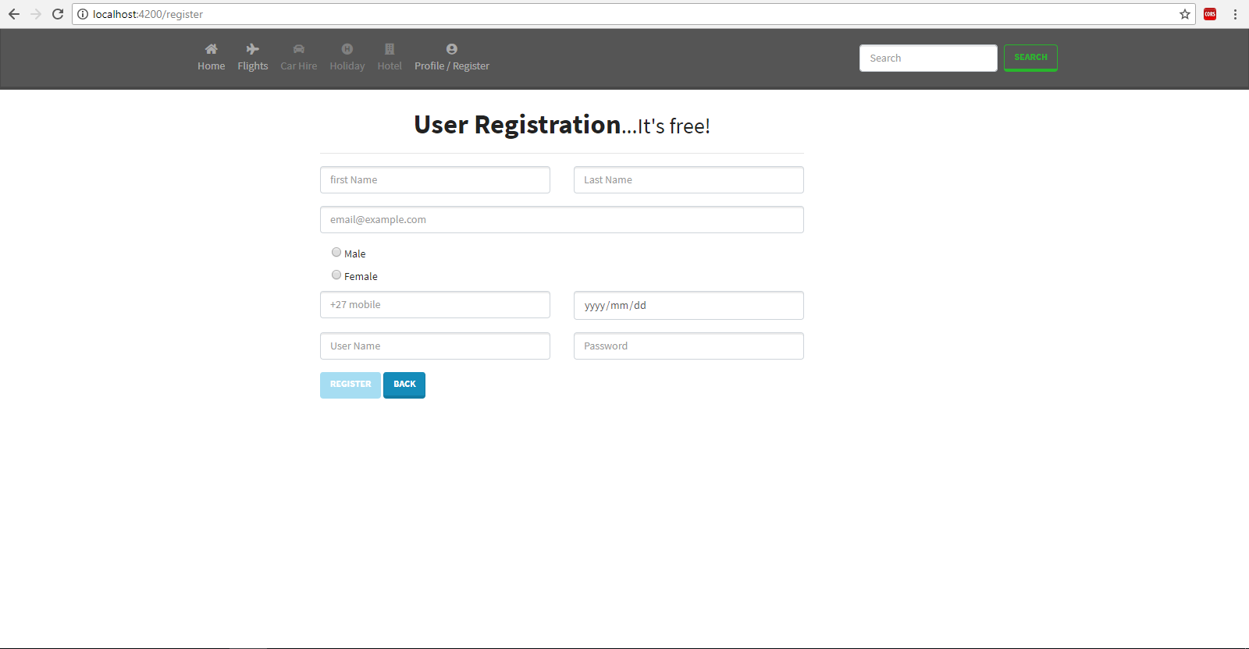

Slide 17
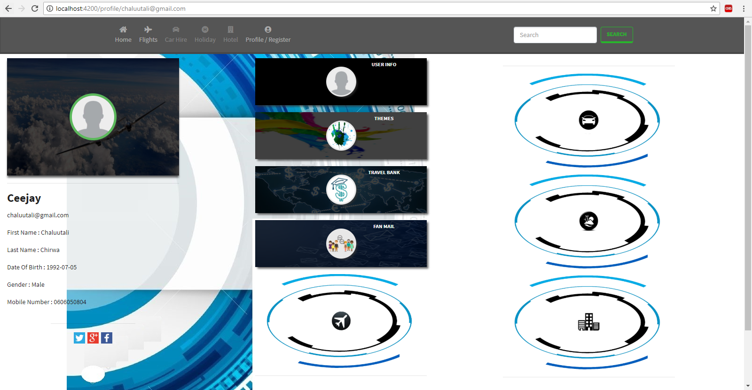
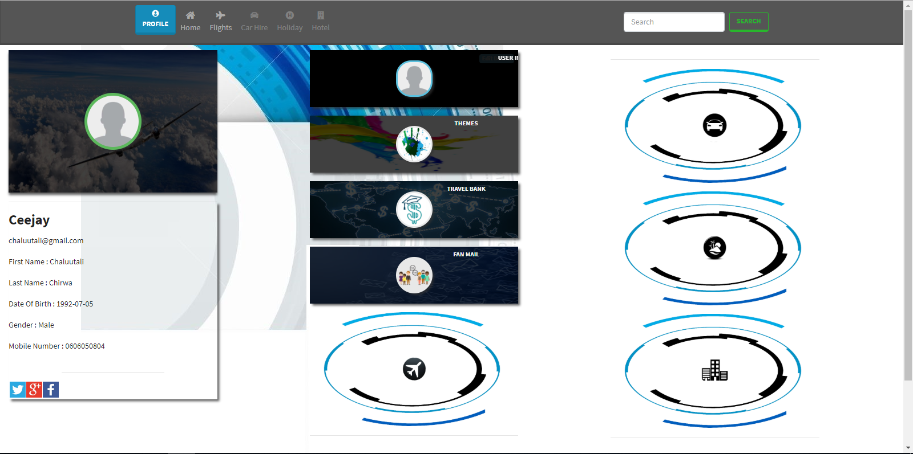

Slide 18
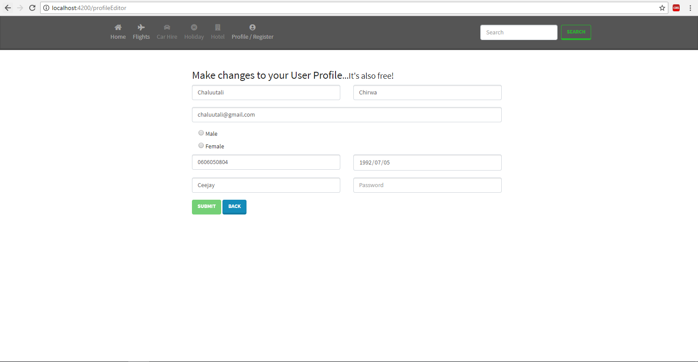

Slide 19
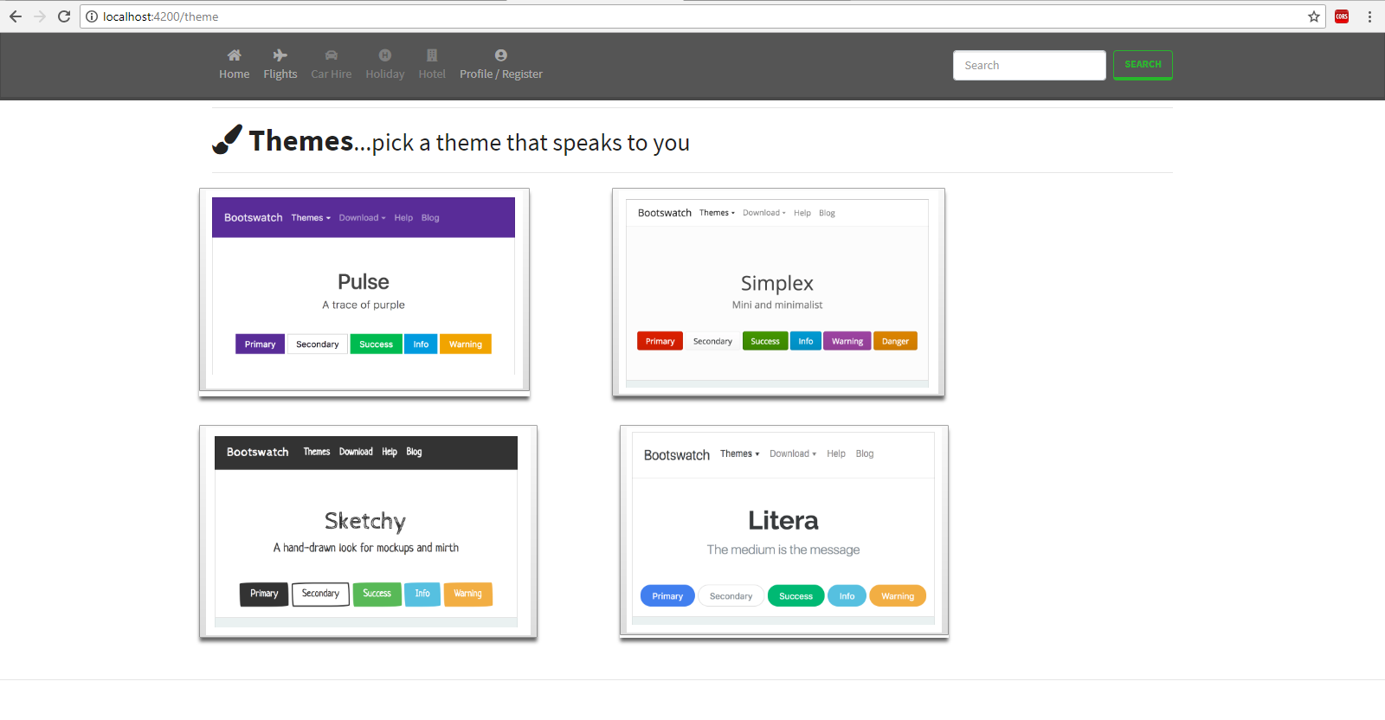
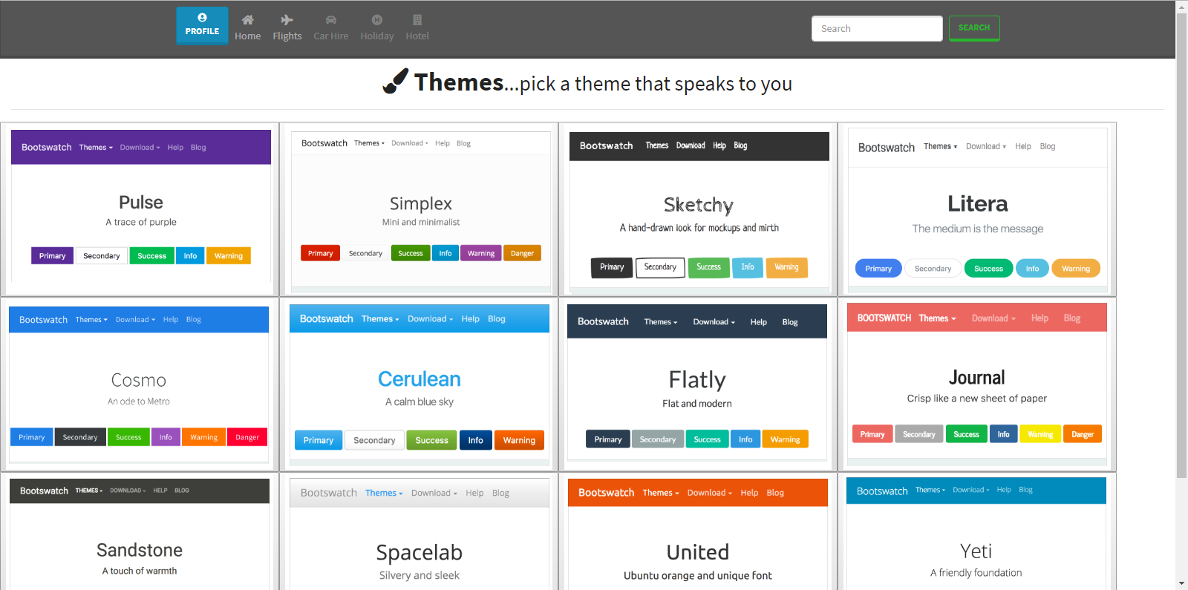

Slide 20
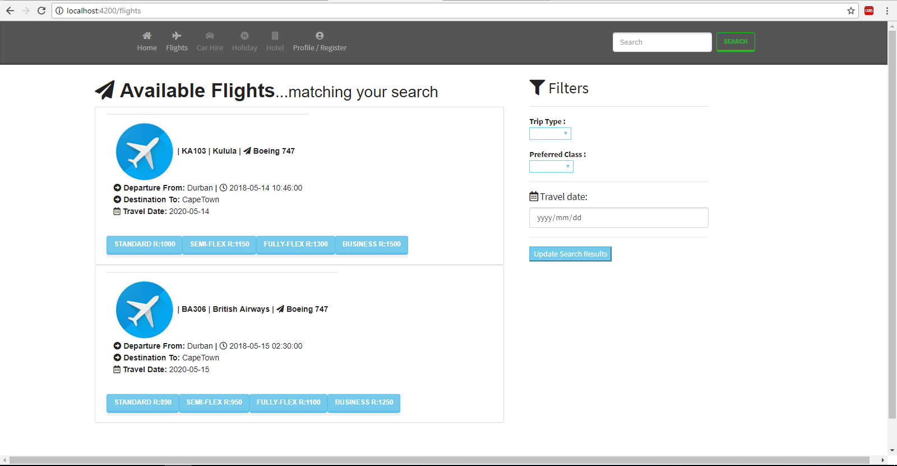

Slide 21
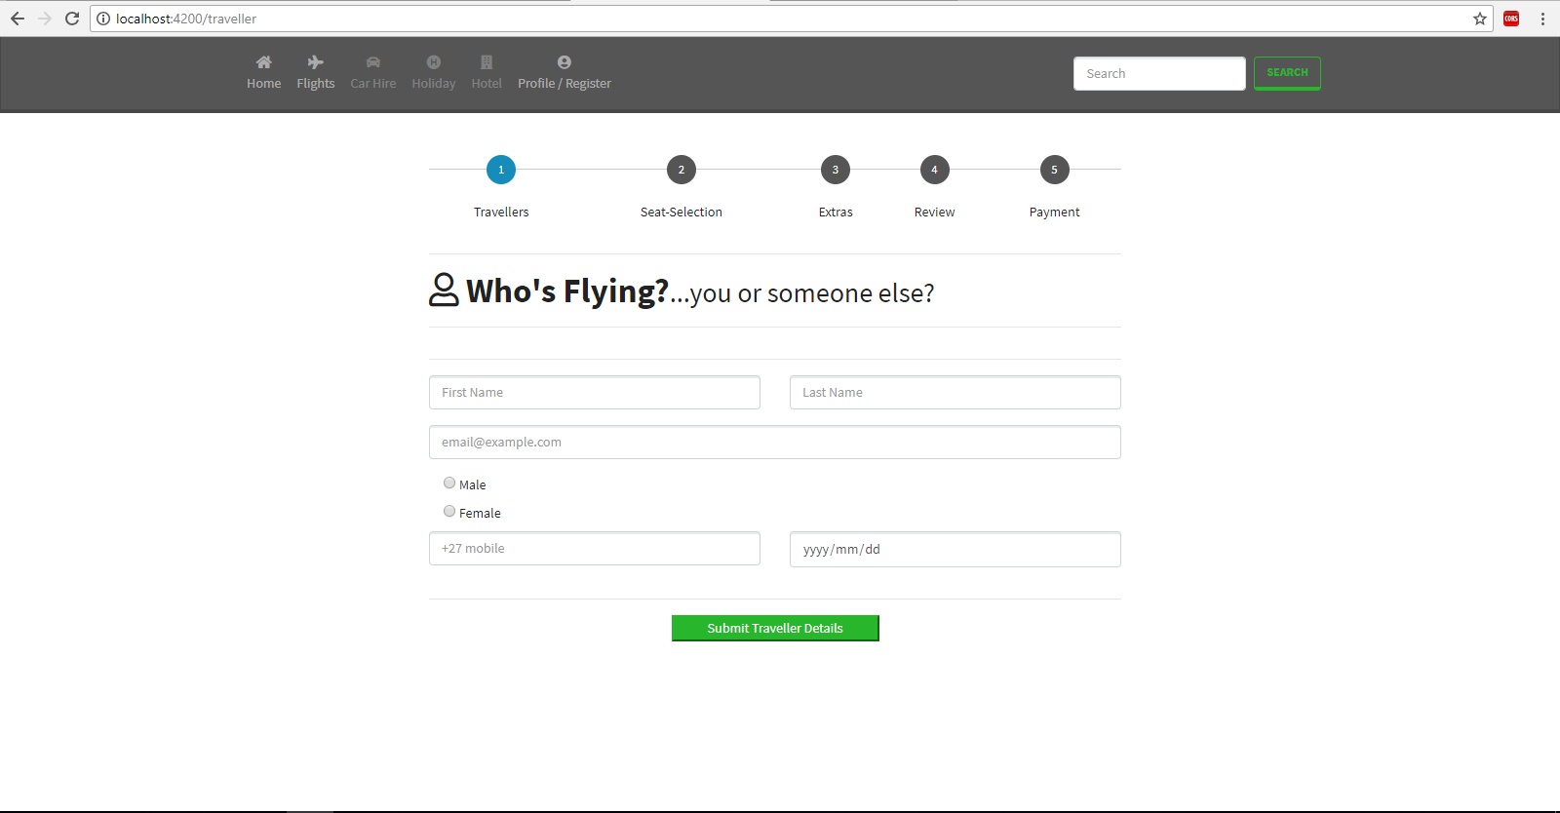

Slide 22
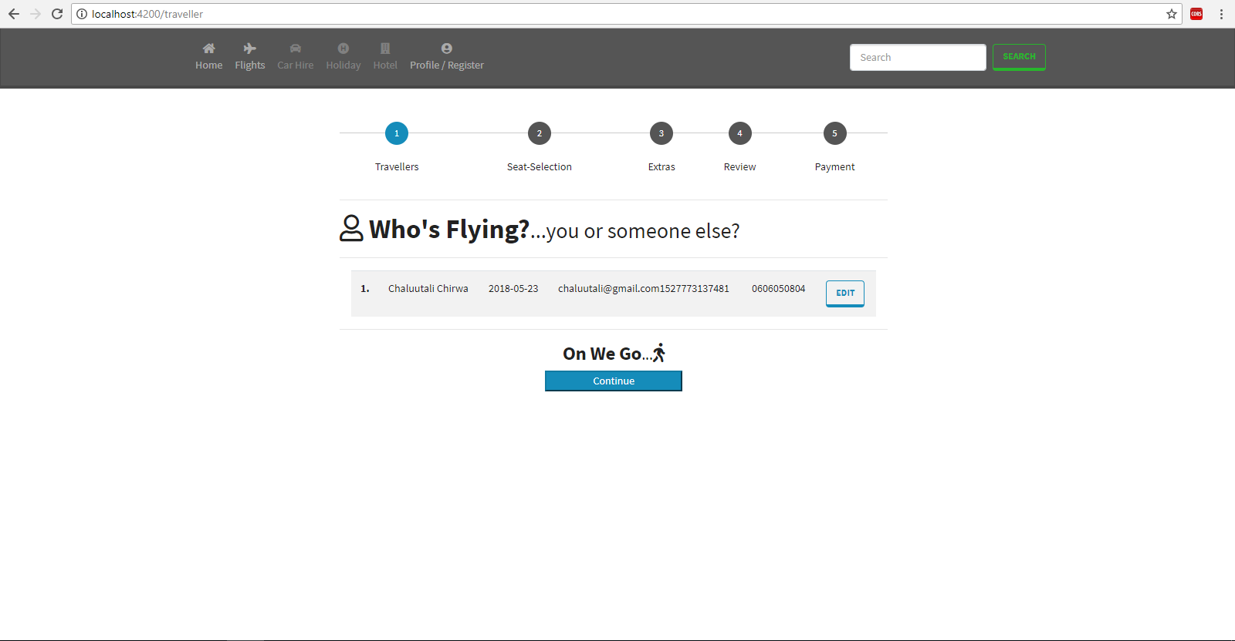

Slide 23
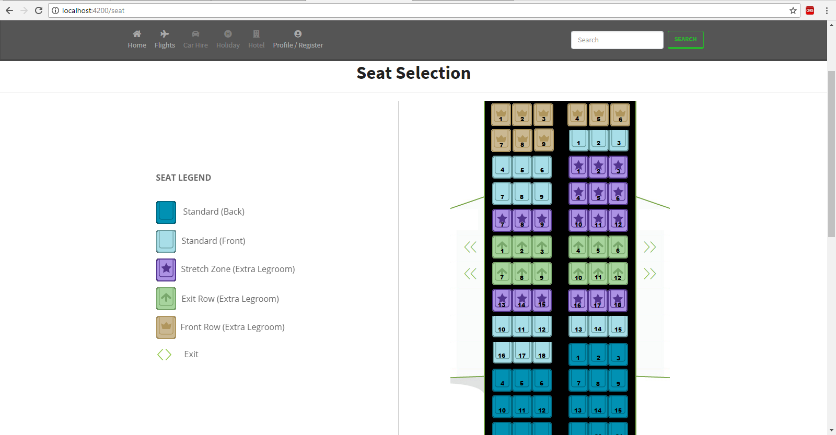

Slide 24
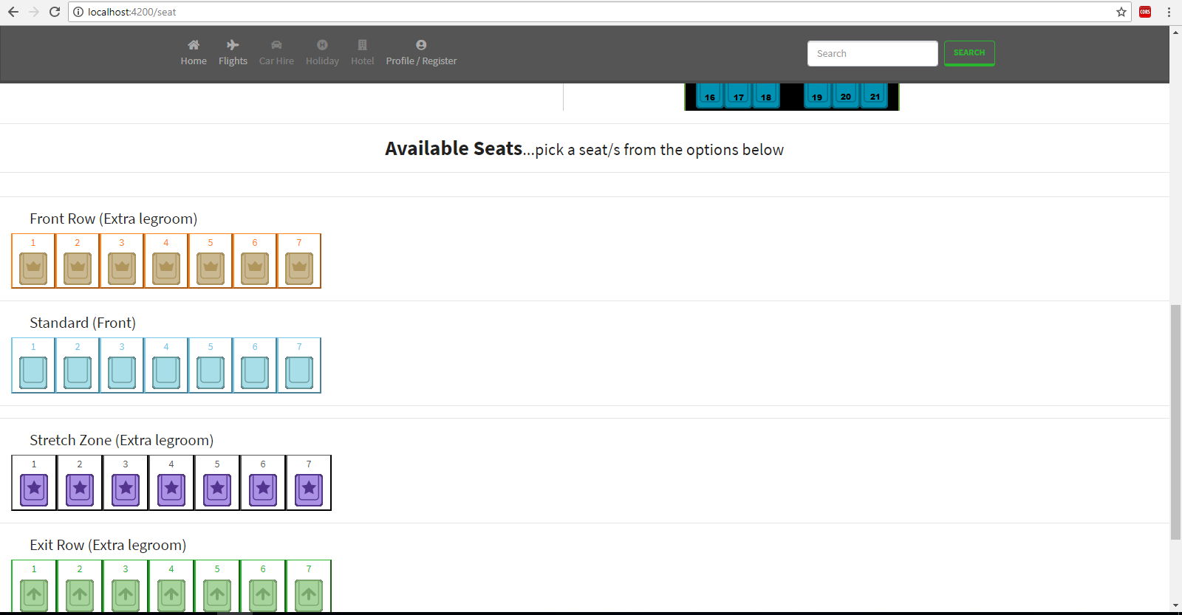

Slide 25
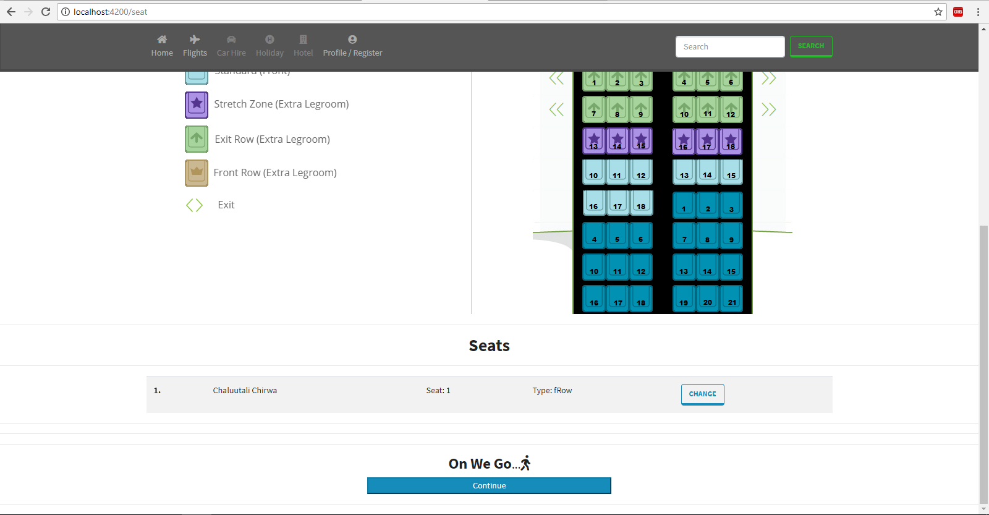

Slide 26
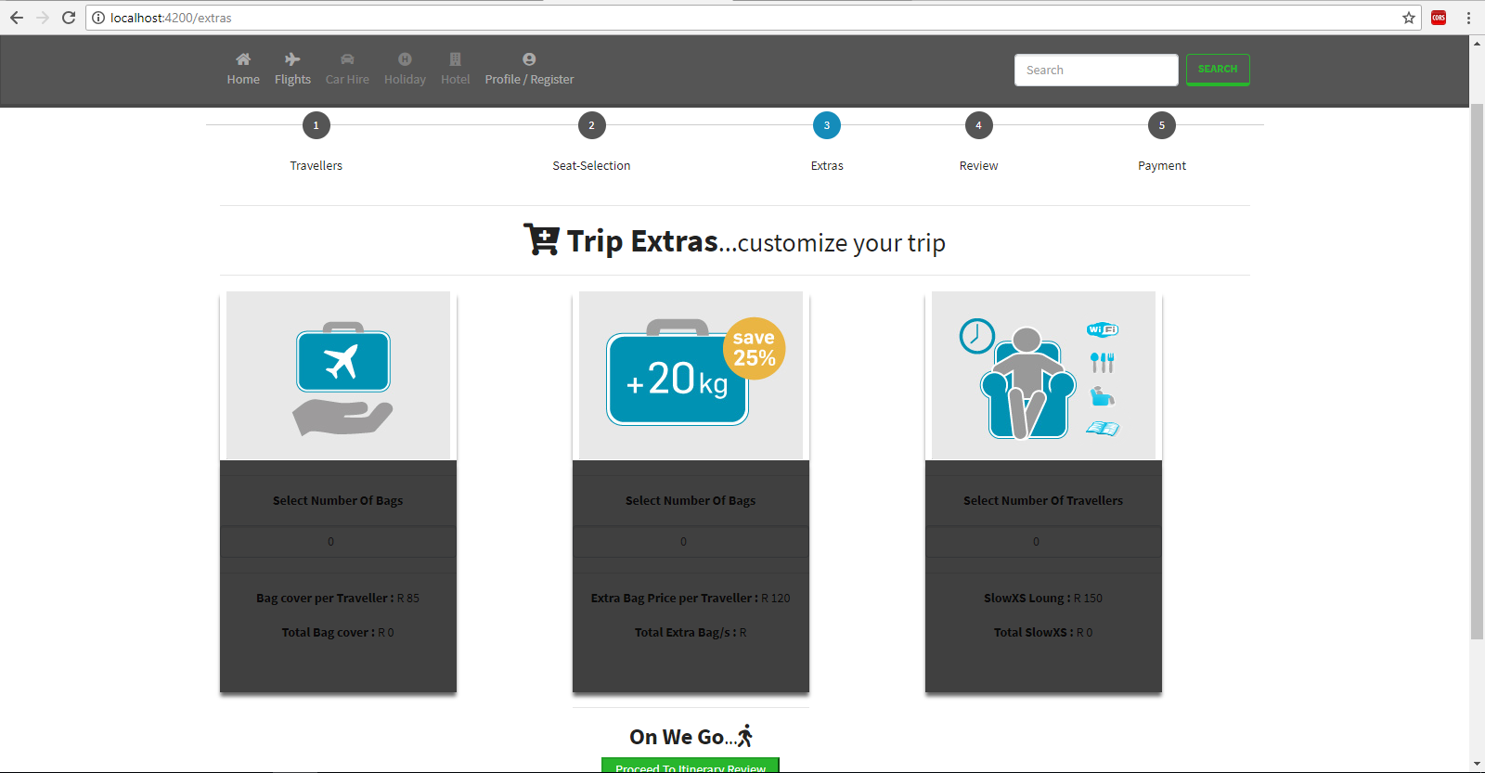

Slide 27
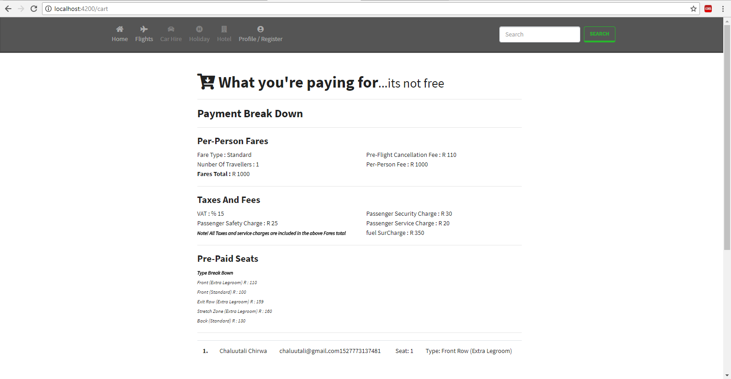

Slide 28
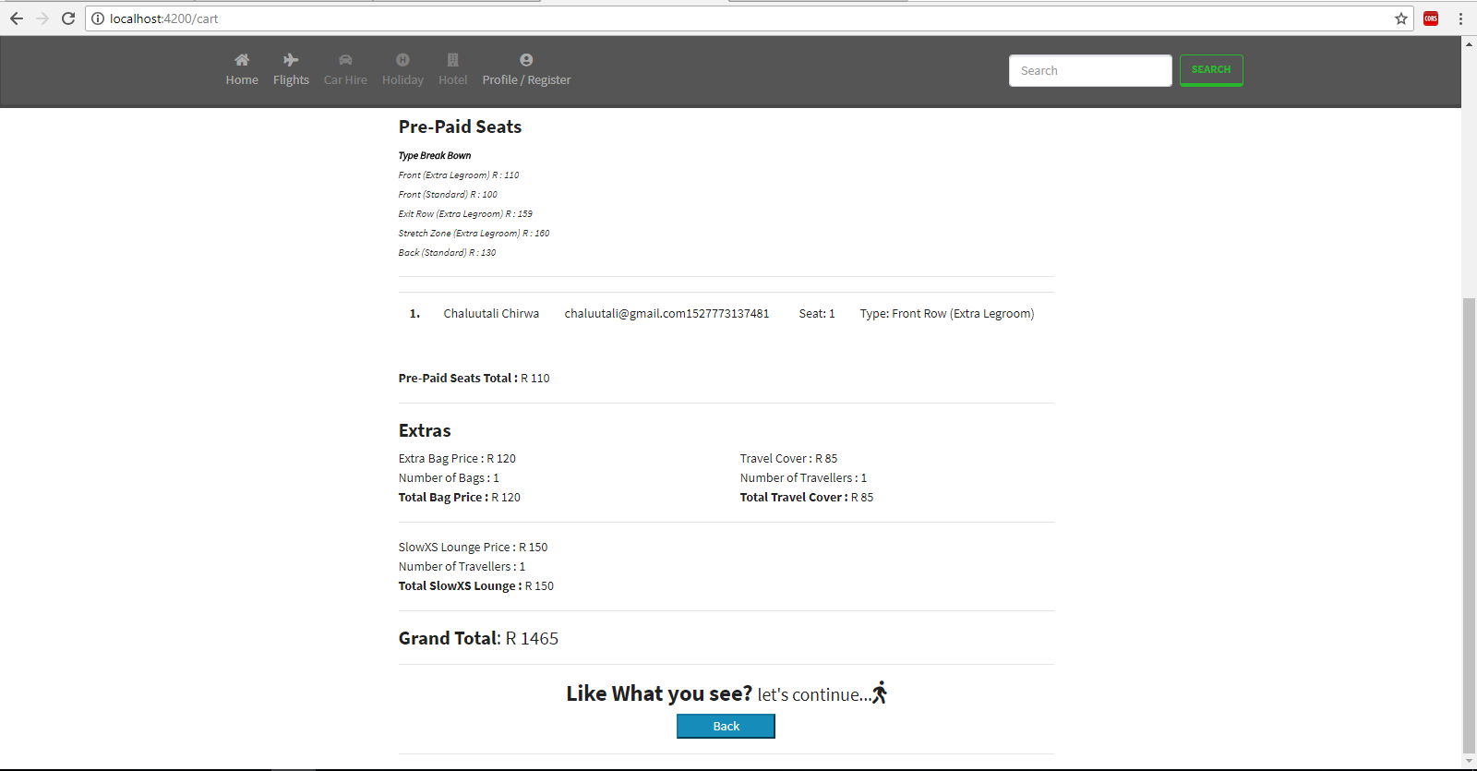

Slide 29
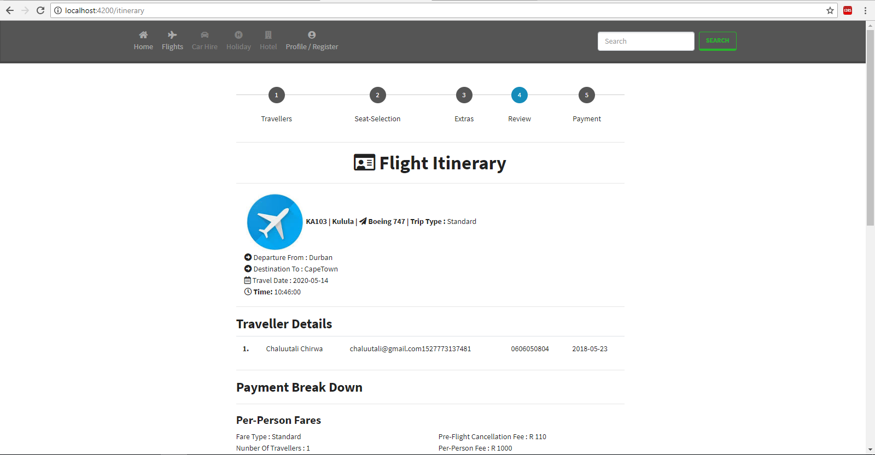

Slide 30
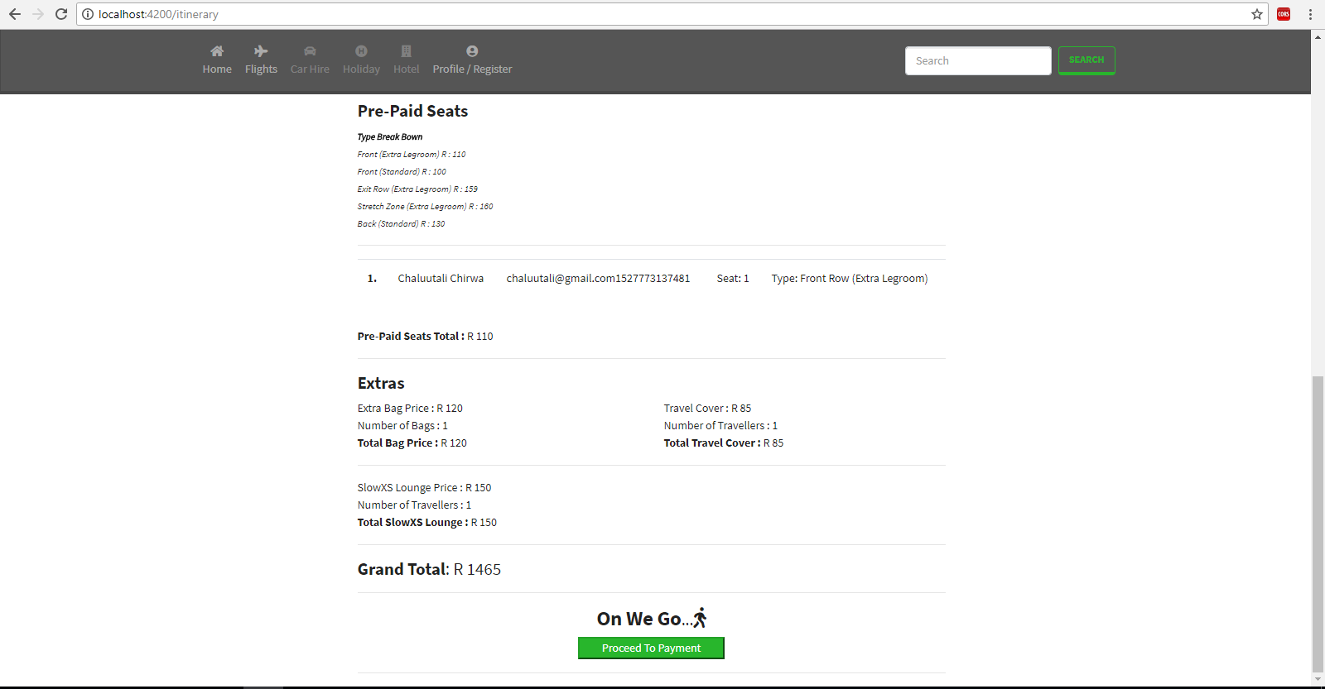

Slide 31
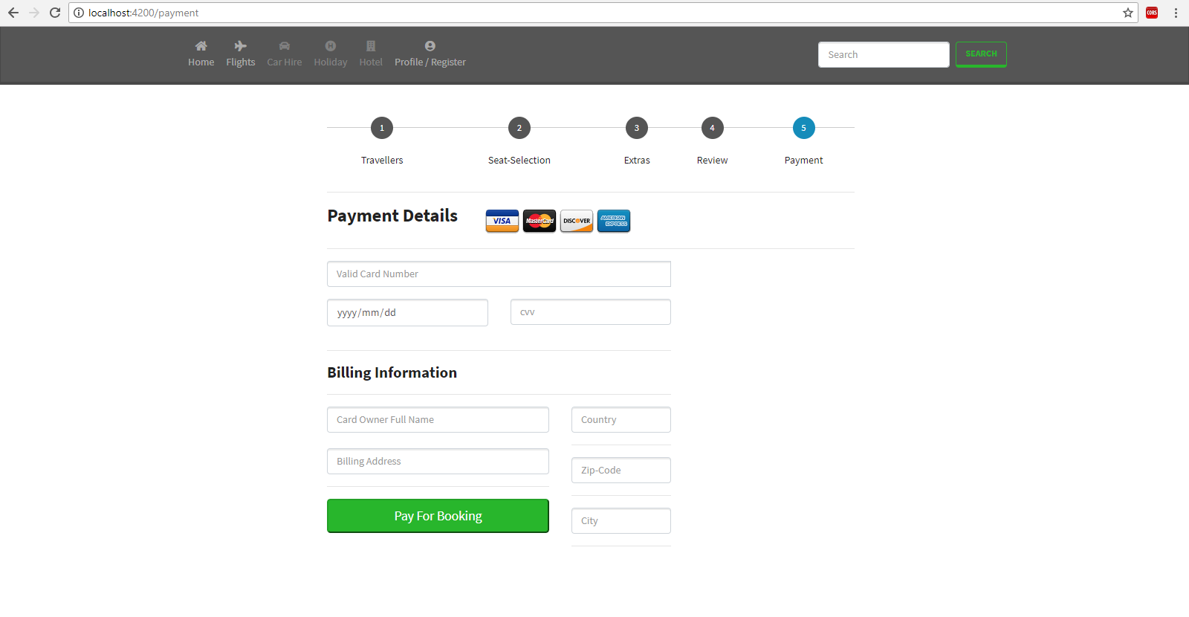

Slide 32
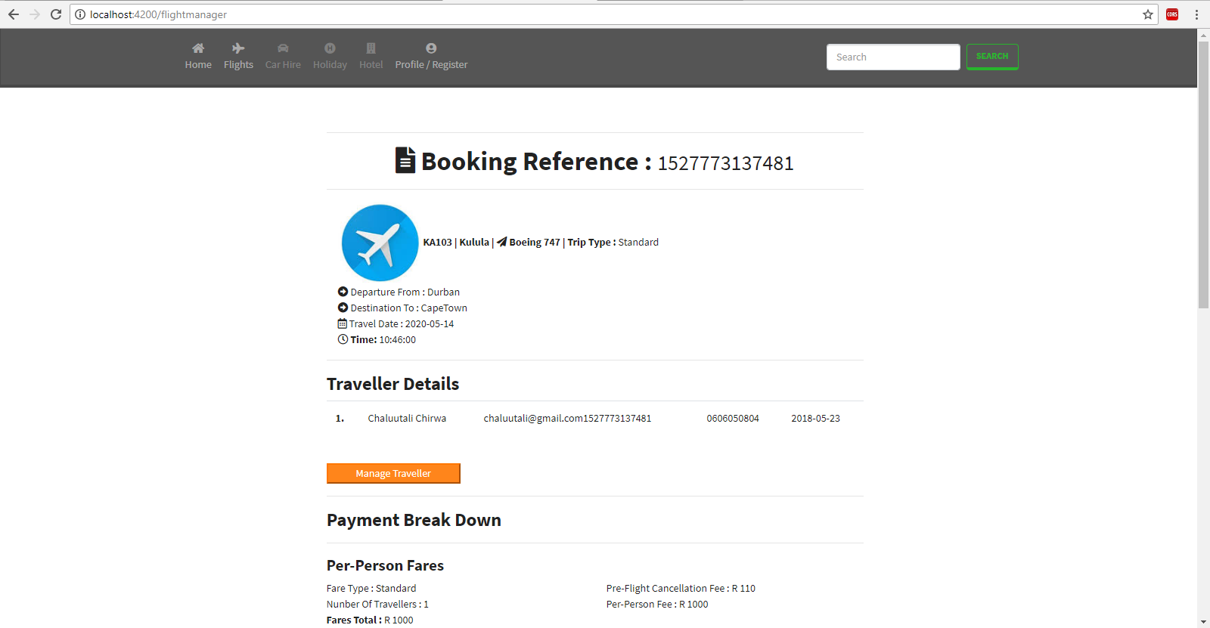

Slide 33
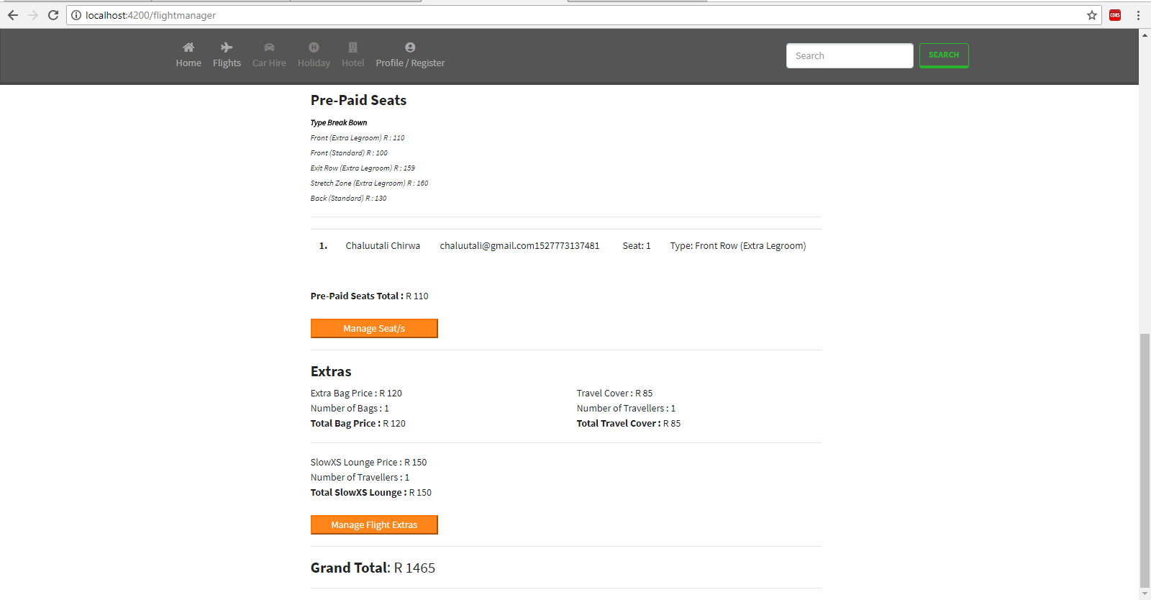

Slide 34
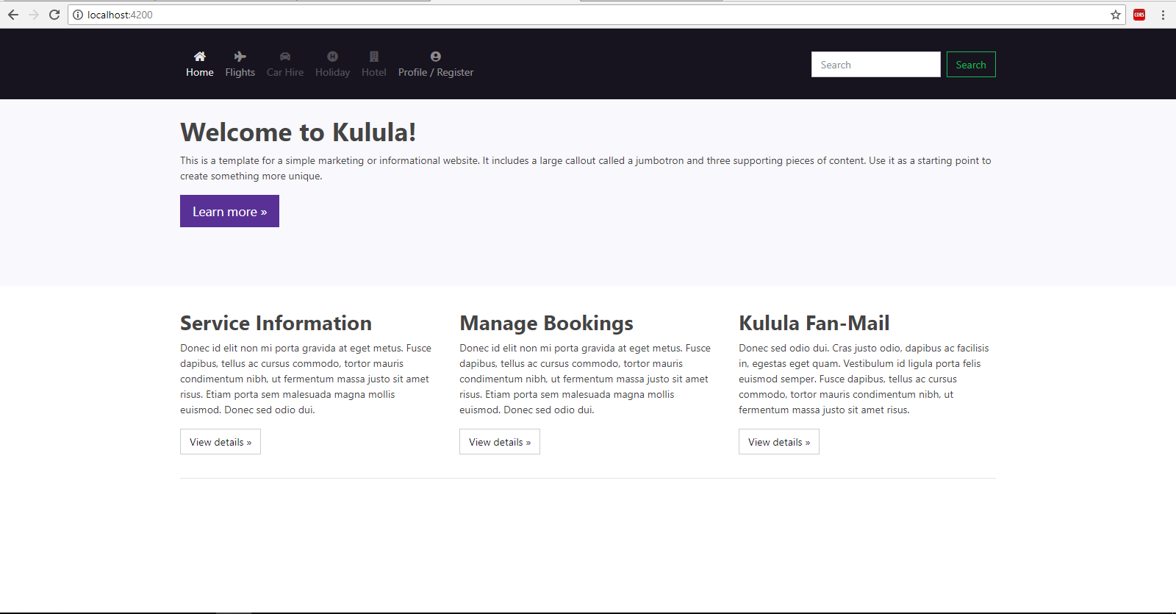

Slide 35
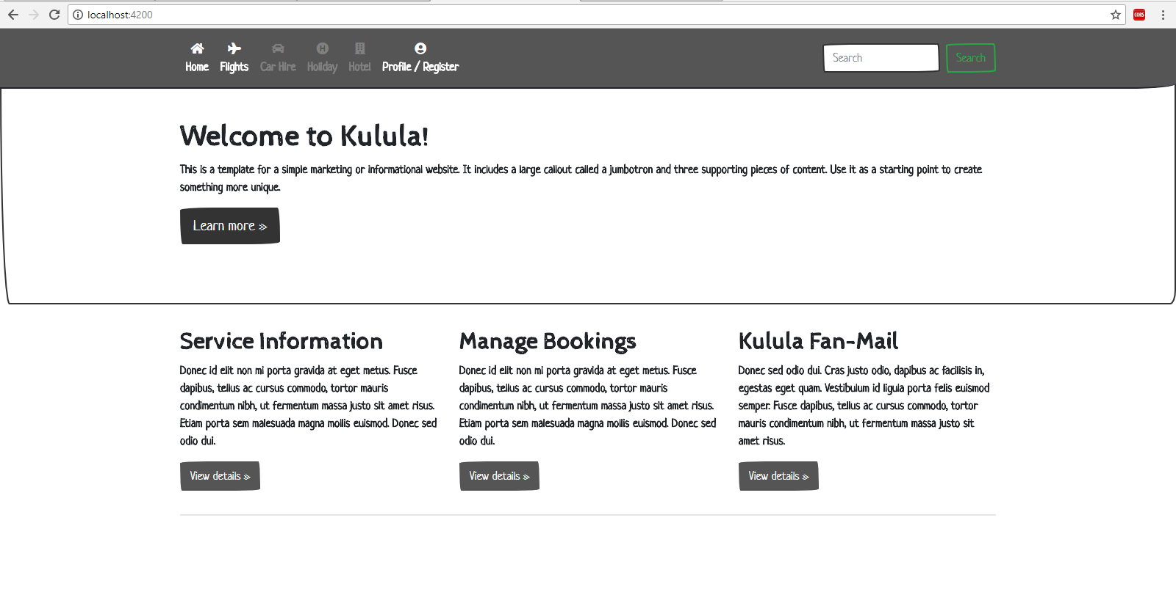

Slide 36
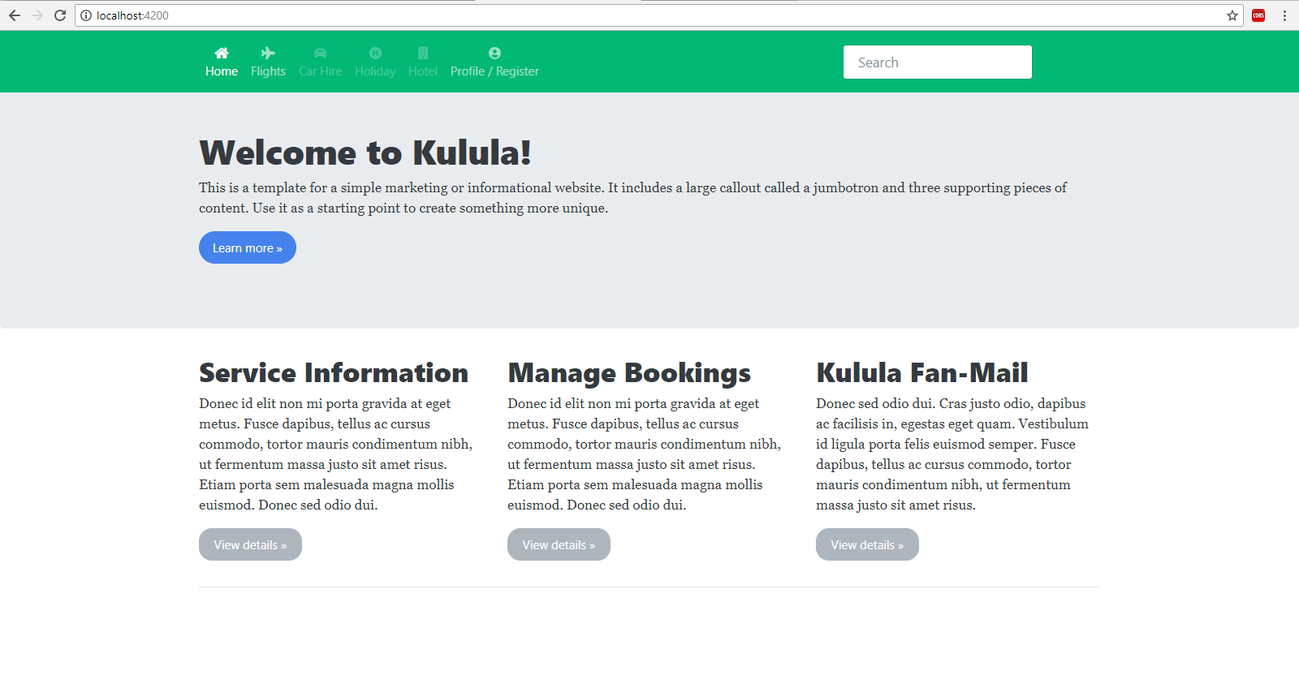

Slide 37
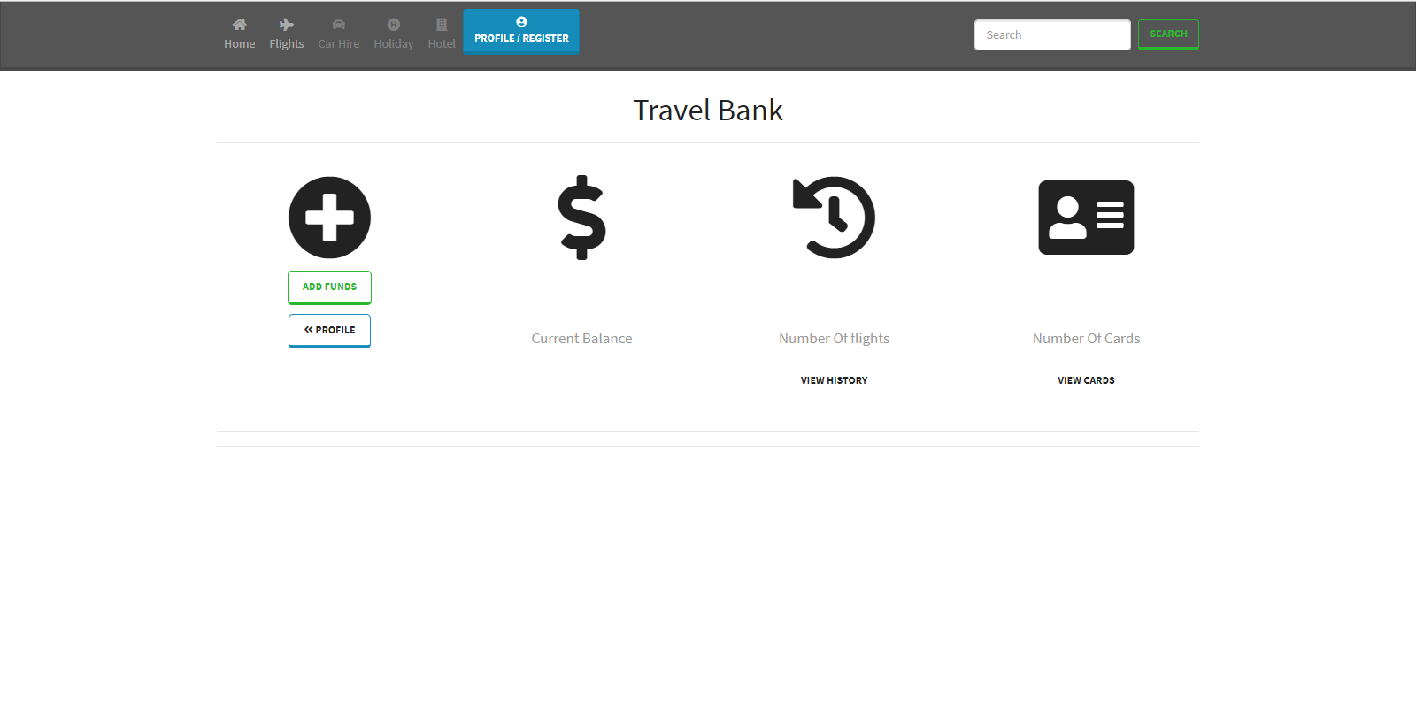
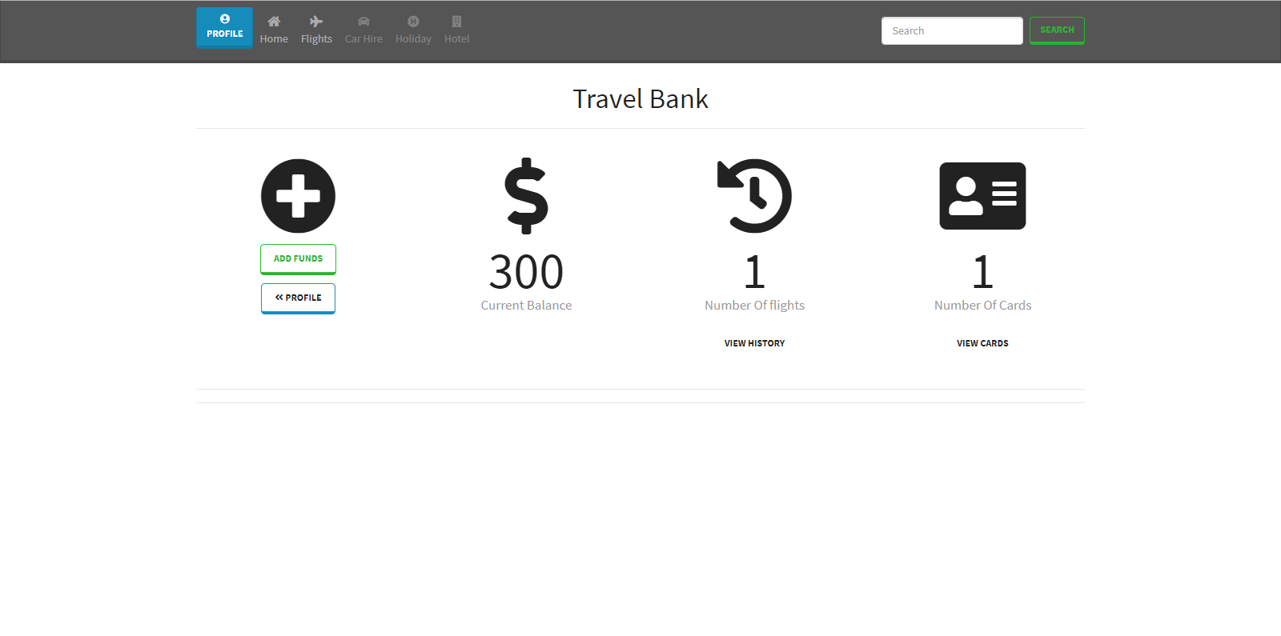

Slide 38
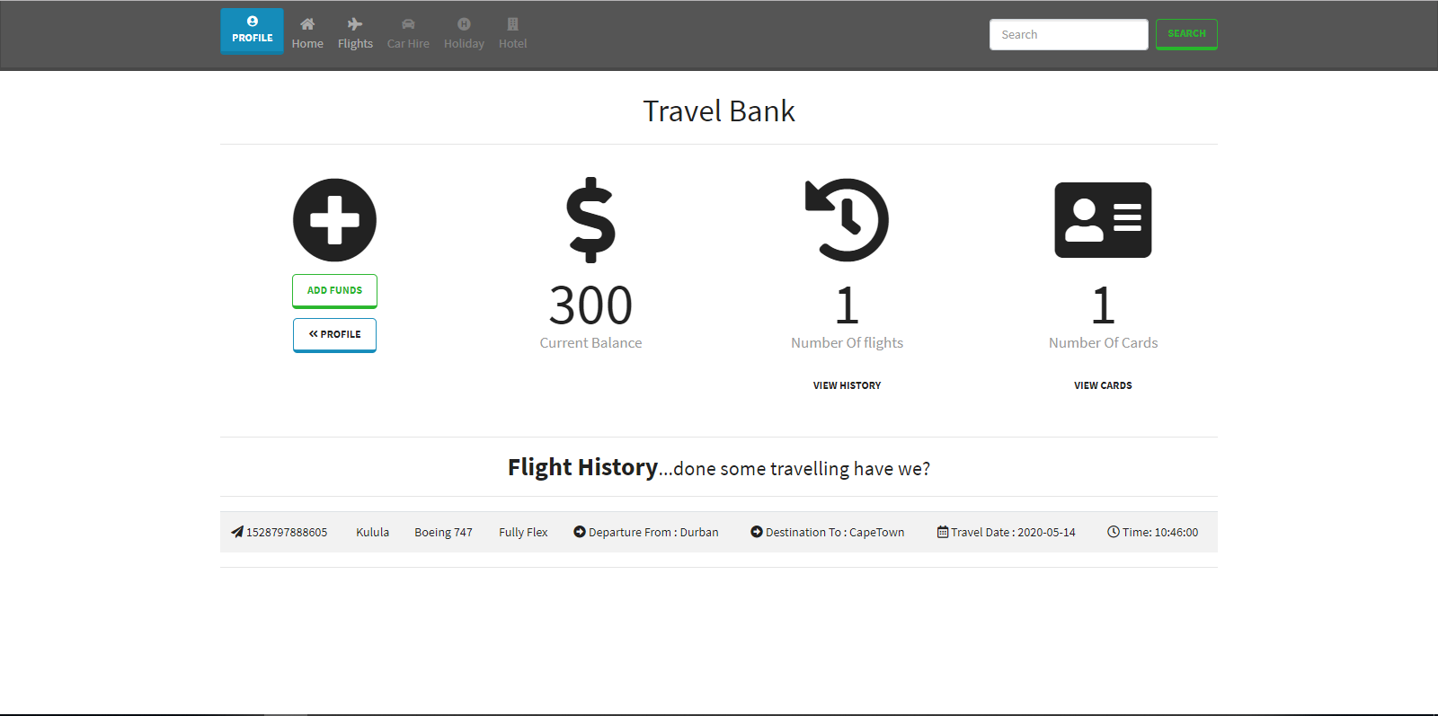

Slide 39
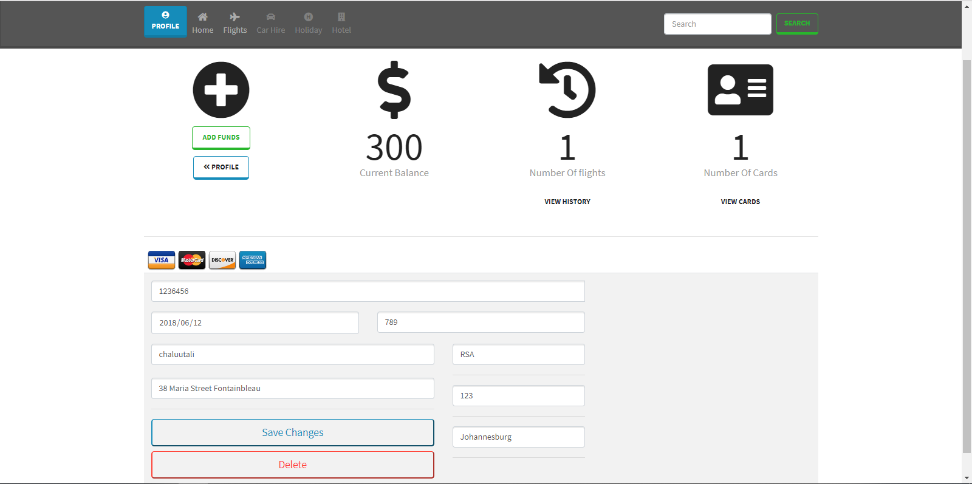

Slide 40
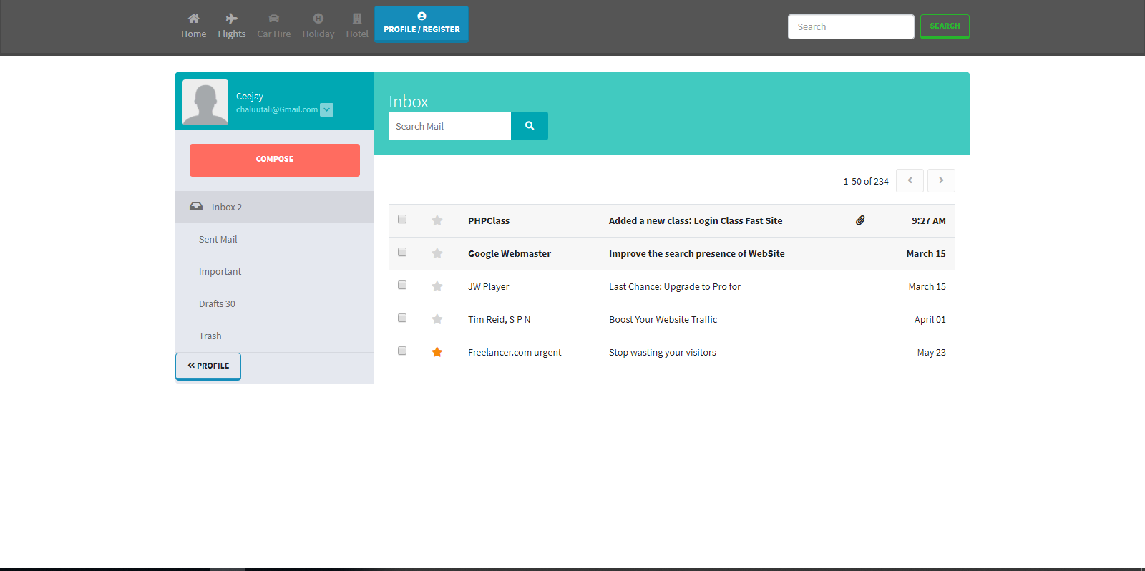
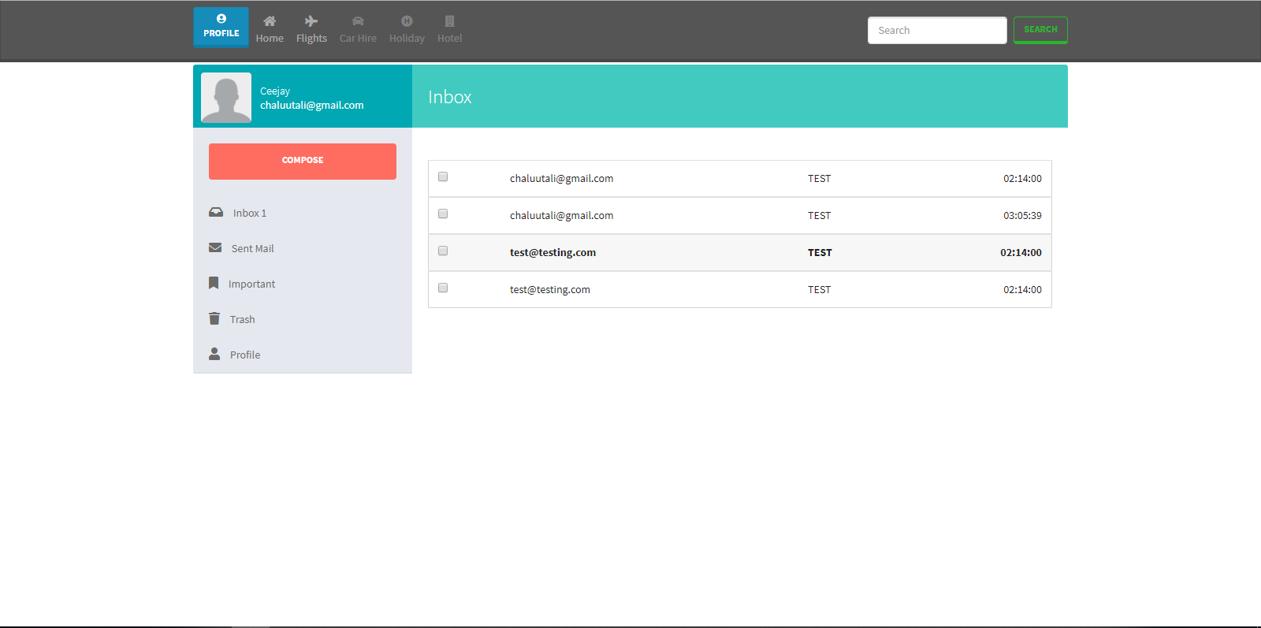

Slide 41
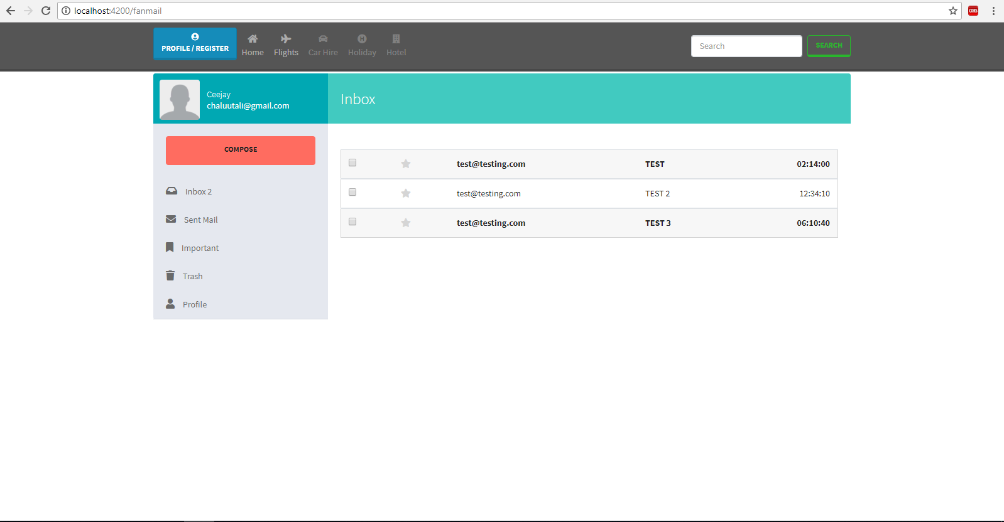

Slide 42
